Slide 1
Module 3: Lesson 1 The Path to MapReduce

Slide 2
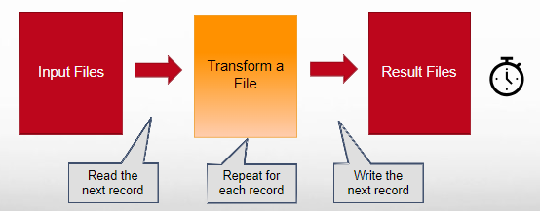
How Do We Process Data of “Small to Moderate” Volume?
Approach
Design and code a sequential process on one server
Limitation
Increasing data volumes leads to processing, storage and memory bottlenecks

Slide 3
How Do We Process Data of “Massive” Volume?
The only feasible approach to tackling big data problems today is to divide and conquer, a fundamental concept in computer science
The basic idea is to partition a large problem into smaller sub-problems
To the extent that the sub-problems are independent, they can be tackled in parallel by different workers (threads, cores, CPUs)
Intermediate results from each individual worker are then combined to yield the final output
The general principles behind divide-and-conquer algorithms are broadly applicable to a wide range of problems in many different application domains
However, the details of algorithm implementation are varied and complex

Slide 4
How Do We Process Data of “Massive” Volume?
Think of a file holding a list of hundreds of billions of numbers to total..
Imagine that adding numbers together is computationally expensive
1
2
4
●●●
34
2700
11
●●●
3423
2
890
●●●
123
456

Slide 5
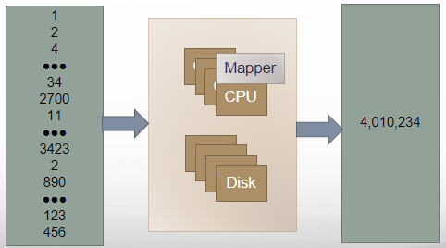
How Do We Process Data of “Massive” Volume?
We could use one very powerful server to calculate the total… using a “mapper” function

Slide 6
Pseudocode for calculating the total using one very large server
Function driver() {
Call init() to set the total to 0
Open some file
For each record in the file {
next_record =
read next record from the file
Call map (next_record)
}
Call final() to output the total
}
total = 0
Function init () {
total = 0
}
Function map (record) {
value = parse value from record
total = total + value
}
Function final () {
output the total
}

Slide 7
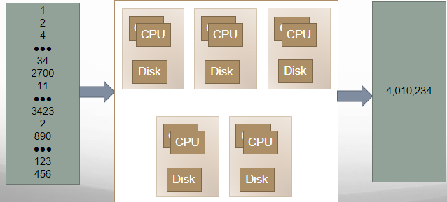
How Do We Process Data of “Massive” Volume?
Or we could use a cluster of less costly but less powerful servers…

Slide 8
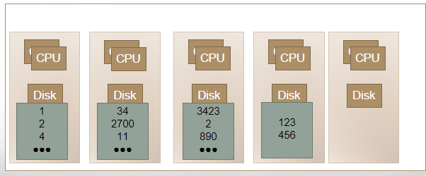
How Do We Process Data of “Massive” Volume?
To do so let’s store the file into HDFS to divide the file into blocks, then distribute these blocks across our cluster

Slide 9
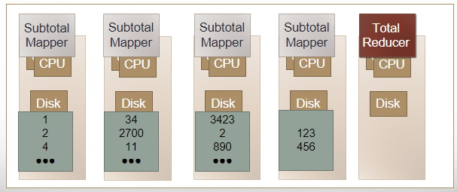
How Do We Process Data of “Massive” Volume?
Now distribute a function (the subtotal mapper) to multiple nodes to calculate partial (per block) totals and another function (the total reducer) to another node to calculate the overall total

Slide 10
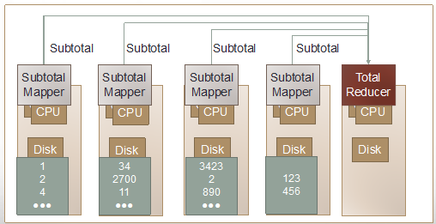
How Do We Process Data of “Massive” Volume?
Now execute all the subtotal mapper functions in parallel

Slide 11
Pseudocode sent to each node to calculate the per block partial totals
<In parallel on each node>
Function driver() {
Call init() to set the partial_total to 0
Open some block of an HDFS file
For each record in the block {
next_record =
read next record from the block
Call map (next_record)
}
Make the partial_total available to the
reducer on demand
}
partial_total = 0
Function init () {
partial_total = 0
}
Function map (record) {
value = parse value from record
partial_total =
partial_total + value
}

Slide 12
How Do We Process Data of “Massive” Volume?
Now execute the total reducer function to (1) collect the partial subtotals from each of the mapper nodes, (2) sum the collected subtotals and (3) place the total into another HDFS file in the cluster

Slide 13
Pseudocode for calculating the final total from all the partial totals
Function reduce (collection of subtotals) {
final_total = sum up all subtotals in the collection
output the final_total
}

Slide 14
How Do We Process Data of “Massive” Volume?
The S3 API allows you to read just a byte range of an S3 object, so each node is assigned the next 64MB range

Slide 15
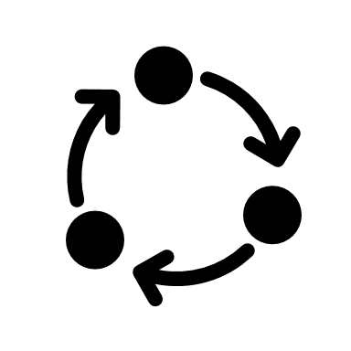
How Do We Process Data of “Massive” Volume? Conceptual Architecture

Slide 16
How Do We Process Data of “Massive” Volume? Challenges
How do we break up a large problem into smaller tasks?
More specifically, how do we decompose the problem so that the smaller tasks can be executed in parallel?
How do we assign tasks to workers distributed across a potentially large number of machines?
While keeping in mind that some workers are better suited to running some tasks than others, e.g., due to available resources, locality constraints, etc.
How do we ensure that the workers get the data they need?
How do we coordinate synchronization among the different workers?
How do we share partial results from one worker that is needed by another?
How do we accomplish all of the above in the face of software errors and hardware faults?

